Slide 1

THE ANEMIAS
Inadequate Construction
VS.
Excessive Destruction

Slide 2
Levels Of Anemia
Hemoglobin less than 11
Hemoglobin less than 9: Moderate
Hemoglobin less than 7: Severe

Slide 3
Hypoxia
Low PO2
Oxygen Content= Hemoglobin + PO2
Acute signs/symptoms:
Chronic signs/symptoms:

Slide 4
Adaptation to Chronic Hypoxia:
Increased erythropoietin: polycythemia
Increased mitochondrial density
Increased angiogenesis: causes clubbing

Slide 5
Cyanosis
Five grams of hemoglobin are FULLY desaturated

Slide 6
Who Gets Cyanotic First?
5/25 = 0.20
5/8 = 0.63
Anemia protects you from cyanosis
Polycythemia predisposes you to cyanosis

Slide 7
Two Ways to Approach Anemia
(1) Check RETICULOCYTE COUNT

Slide 8
Anemic
Low RETICULOCYTE count
Hypo-proliferative
(1) Something is MISSING from the bone marrow or…
(2) Bone marrow is suppressed
High RETICULOCYTE count
Hyperproliferative
Hemolytic Anemia
  Intravascular
  Extravascular

Slide 9
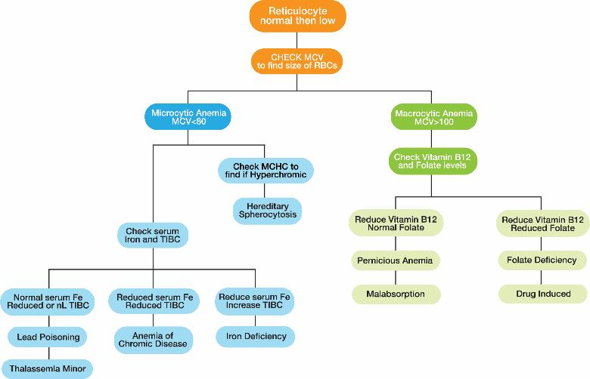
Figure 7. 1 Anemia Classification based on Reticulocyte Count

Slide 10
Hemolytic Anemia
Intravascular Hemolysis
Vasculitis in progress
Schistocytes
  Burr Cells
  Helmet Cells
Low Haptoglobin
Extravascular Hemolysis
Abnormal membrane structure
Splenomegaly

Slide 11
Extravascular Hemolysis
Mcc: Autoimmune hemolysis: Do coombs test

Slide 12
Drugs That Cause Extravascular Hemolysis
Penicillins
Cephalosporins
Sulfa
Dapsone
Alpha Methyl Dopa
PTU
HIPPPE

Slide 13
Paroxysmal Nocturnal Hemoglobinuria
First described in military recruits
RBCs are sensitive to hemolysis by acidosis
HAMS test

Slide 14
Markers for PNH
CD55
CD59

Slide 15
Eculizumab
Blocks C5
Blocks the MAC complex

Slide 16
Hereditary Spherocytosis
Autosomal Dominant
SPECTRIN defect
Osmotic fragility test

Slide 17
Hereditary Elliptocytosis
Autosomal Dominant

Slide 18
Some RBCs can talk…if you listen
Here is what they have to say…
Reticulocyte
Spherocyte
Elliptocyte
Schistocyte
Tear Drop Cell
Target Cell
Heinz Body
Basophilic Stippling
Acanthocytes
Anisocytosis
Poikilocytosis

Slide 19
Howell-Jolly Bodies
Remnants of the nucleus
Nucleus normally removed by bone marrow or by spleen
If present:
  Hemolytic anemia
  Splenectomy
    Trauma is most common cause

Slide 20
Reticulocytes
New RBC that just came out of bone marrow
Normal: 1%
Stimulate bone marrow:
  Reticulocytes first show up: 4 days
  Reticulocytes peak: 7 days

Slide 21
Spherocytes
Most common cause: old RBCs
Hereditary spherocytosis

Slide 22
Elliptocytes
Hereditary elliptocytosis only

Slide 23
Schistocytes
Evidence of a vasculitis
Represents torn RBCs and platelets
Most common in children: Berger’s disease
Most common in adults: Hypertension and DM

Slide 24
Tear Drop Cells
RBCs look like Hershey’s kisses
RBCs are being squeezed out of bone marrow
Most common:
  (1) Hemolytic anemia
  (2) Cancer in bone marrow
    ALL is most common in children
    Metastases most common in adults
      In men: Prostate, lung, colon cancers
      In women: Breast, lung, colon cancers

Slide 25
Target Cells
Means less hemoglobin than normal
Most common cause: iron deficiency

Slide 26
Heinz Bodies
Represents oxidized or precipitated hemoglobin
Most common cause: G6PD

Slide 27
Basophilic Stippling
Excess proteins stuck to the sides of the RBC
Seen in lead poisoning

Slide 28
Acanthocytes
RBCs are coated with lipids
Evidence that patient has hyperlipidemia

Slide 29
Anisocytosis/Poikilocytosis
Different sizes/different shapes
Means you have more than one anemia or you are being treated for one anemia (reticulocytes are showing up)
Most common cause: malabsorption
  In children: cystic fibrosis
  In adults: (1) Crohn’s Disease and (2) Celiac Sprue

Slide 30
The Second Way to Approach Anemia
(2) Order a CBC with Differential

Slide 31
Check a CBC with Differential
MCV (Mean Corpuscular Volume)
MCH (Mean Corpuscular Hemoglobin)
MCHC (Mean Corpuscular Hemoglobin Concentration) = MCH/MCV

Slide 32

Figure 7.2 Anemia Classification based on MCV

Slide 33
Microcytic Hypochromic
Low MCV
Low MCH
Impaired hemoglobin PRODUCTION

Slide 34
Microcytic Hypochromic Anemias
Iron Deficiency
Chronic Disease, late
Lead poisoning
Thalassemias
Hemoglobinopathies
Sideroblastic anemia

Slide 35
Iron Deficiency
Most common causes:
  0 to 20: Poor intake
  20 to 40: Inflammatory bowel disease
  Above age 40: Mucosal bleeding
    In men: Colon
    In women: Endometrial

Slide 36
Late Chronic Disease
Usually after 60 days
Chronic disease begins at 3 weeks
Mechanisms:
  Decreased bone marrow production
  Increased destruction
  Hepcidin production by liver
    Interferes with transferrin ability to bind iron

Slide 37
Iron Deficiency Vs Chronic Disease
Iron Deficiency :
  Low serum iron
  Low iron saturation
  Low ferritin
  High TIBC
Chronic Disease Anemia:
  Low serum iron
  Low iron saturation
  Normal/high ferritin
  Low TIBC

Slide 38
Lead Poisoning
Most common: eating lead from old buildings
Lead screening begins at 12 mo.
Heel stick or toe stick has high NPV
If initial level is high, you must confirm it with a venous sample

Slide 39
Lead Poisoning
0 – 5: Complete H & P, recheck in 6 mo.
5 – 14: Very directed H & P, recheck in 3 mo.
15 – 44: Notify PHD, recheck in 1 mo.
45 – 69: Begin succimer as outpatient, recheck in 1 mo.
Above 70: Hospitalize; treat with chelation
  Two drugs if neurological symptoms
  One drug if no neurological symptoms
  Drugs: Ca-EDTA; Dimercaprol (BAL); penicillamine

Slide 40
Thalassemias
Alpha Thalassemia: has four genes
  Alpha minor (one gene missing): asymptomatic
  Alpha minor (two genes missing): +/- symptoms
  Alpha minor (three genes missing): symptomatic
  Alpha major (four genes missing: dies in utero at 4 mo. gestation of hydrops fetalis
Beta Thalassemia: has two genes
  Beta minor (one gene missing): increases HgA2, HgF
  Beta major (both genes missing): asymptomatic till 6 mo., then becomes transfusion dependent

Slide 41
Hemoglobinopathies
Hemoglobin S: Valine for glutamate at position 6 of beta chain
Hemoglobin C: Lysine for glutamate at position 6 of beta chain

Slide 42
Sideroblastic Anemia
Macrophages are ingesting too much iron
Prussian blue stain positive

Slide 43
Microcytic Hyperchromic
Low MCV
High MCHC (MCH/MCV)
The cells are too small

Slide 44
Microcytic Hyperchromic Anemias
Hereditary Spherocytosis
Diagnosis: Eosin 5 maleimide test

Slide 45
Normocytic Normochromic
Normal MCV
Normal MCH
NOTHING is wrong with the RBCs…
You do not have enough of them

Slide 46
Normocytic Normochromic Anemias
Acute Hemorrhage (less Than 4 days)
Chronic disease, early
Renal failure
Hypothyroidism, early
Aplastic anemia
Myelofibrosis
Diamond Blackfan Syndrome
Fanconi’s Syndrome

Slide 47
Renal Failure
Most common in children: HUS
Most common in adults: (1) HTN and (2) DM

Slide 48
Hypothyroidism
Most common in newborns: thyroid dysgenesis or agenesis
Most common in adults: Hashimoto’s Disease
  Anti-TPO Antithyroglobulin Anti-microsomal
Most common worldwide: Iodine deficiency

Slide 49
Pure RBC Aplasias
Diamond Blackfan Syndrome
Fanconi’s Anemia
Seen early in first year of life
All other bone marrow cells are normal
Has three leaf clover shaped thumb
Usually seen in adults
Associated with thymomas
RBCs disappear first, then other cells follow

Slide 50
Bone Marrow Wiped Out
Aplastic Anemia
Myelofibrosis
Caused by virus or drug toxicity
Bone marrow replaced by fat
Caused by cancer
Bone marrow replaced by scar tissue

Slide 51
Macrocytic Anemia
High MCV
Impaired nuclear division

Slide 52
Macrocytic Anemias
B12 Deficiency
Folate Deficiency
Hypothyroidism, severe
Reticulocytosis
Alcohol
Chemotherapy drugs
Anticonvulsants

Slide 53
Vitamin B12 Enzymes
Methylmalonyl-CoA Mutase
Homocysteine Methyltransferase

Slide 54
Vitamin B12 Vs. Folate
Vitamin B12
Folate
Has neuropathy
Takes 3 to 4 years to become deficient
Methylmalonic acid elevated in urine
No neuropathy
Develops in a short period

Slide 55
Macrocytic Anemias
B12 Deficiency
Folate Deficiency
Hypothyroidism, severe
Reticulocytosis
Alcohol
Chemotherapy drugs
Anticonvulsants

Slide 56
Anticonvulsants
Phenytoin
Ethosuximide
Valproic Acid
Carbamazepine

Slide 57
Phenytoin
Blocks Na cannels & calcium channels
Blocks folate by accident
Gingival hyperplasia and hirsutism
Pseudolymphoma
Neonatal syndrome: jaw and nail deformities
Drug of choice for generalized seizures in adults

Slide 58
Ethosuximide
Blocks calcium channels
Drug of choice for absence seizures
Bone marrow suppression
Drug induced Lupus

Slide 59
Valproic Acid
Blocks Na, Calcium
Blocks folate
Bone marrow suppression
Neural tube defects
Drug of choice for mixed and myotonic seizures
Drug of choice for acute mania

Slide 60
Carbamazepine
Blocks Na and calcium
Causes agranulocytosis
Drug of choice for temporal lobe seizures
Second line drug for acute mania
Drug of choice for shooting, stabbing, lancinating neuropathy

Slide 61
Lamotrigine
Blocks Na and calcium
Safe in pregnancy
Causes Type 1 hypersensitivity rashes

Slide 62
Organization is the key!

